Slide 1
NLP
(Natural language Processing)

Slide 2
Agenda
Natural Language Understanding (NLU)
  Cohesion
  Coherence
  Cohesive devices
    References,
    Ellipsis,
    Substitution,
    Conjunction,
    Lexical cohesion
  Summary of cohesion
  Cohesion vs coherence
  Bibliography
The End

Slide 3
Cohesion
Definition 1:
Cohesion is the grammatical and lexical linking within a text or sentence that holds a text together and gives it meaning.
Cohesion is the grammatical and lexical relationship within a text or sentence and can be defined as the links that hold a text together and give it meaning.

Slide 4
Cohesion
Definition 2:
COHESION refers to linguistic features which link sentences together and are generally easy to identify.
  Example:
    Haseeb belongs to Peshawar. He is in BCS final semester.
    John went to the store. He bought a Pepsi there.”

Slide 5
Cohesion
Definition 3:Cohesion is "the glue that sticks a sentence to another in a paragraph or a paragraph to another in a text."

Slide 6
Coherence
Definition 1:
  Coherence in linguistics is what makes a text semantically meaningful or makes sense.
It is especially dealt with in text linguistics.
Definition 2:
  When sentences, ideas, and details fit together clearly, readers can follow along easily, and the writing is coherent.

Slide 7
Coherence
Example 1:
  There once was a farmer in a small village. He worked hard day and night in his fields to fed his wife and children.
Example 2:
  Ali was a studious student and got 900 marks. His percentage is 92.1%.

Slide 8
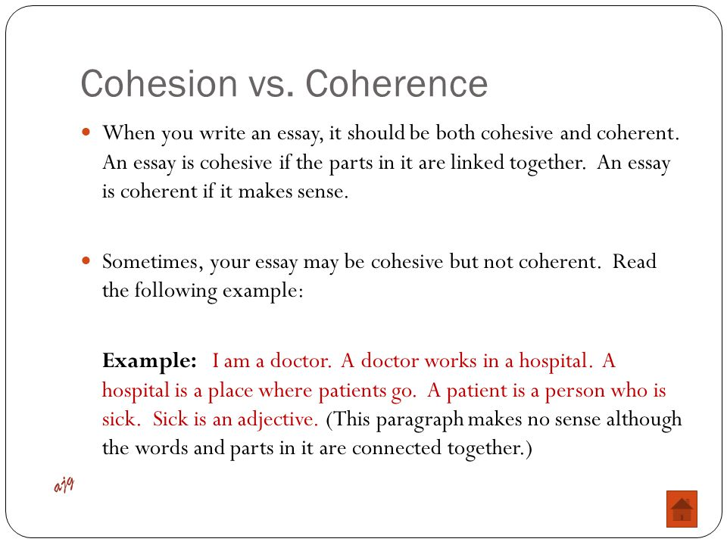

Slide 9
Difference Between Coherence and Cohesion
John went to the store. He bought a Pepsi there.” (both coherence and cohesion)
John went to the store. They all bought a Pepsi there.” (coherence but no cohesion)
“It go off the store. He think five Pepsi here.” (neither coherence nor cohesion)

Slide 10
Why coherence?
It has been stated that a text coheres only if the world around is also coherent.

Slide 11
Cohesive devices
Definition:
Cohesive device is a device which holds different parts of a thing together.
  The links within the text that hold it together are called cohesive devices.
  In terms of communication, cohesive devices are typically single words or phrases that hold and hang different parts of the text

Slide 12
Categories of cohesive devices
A cohesive text is created in many different ways. In Cohesion in English, M.A.K. Halliday and Ruqaiya Hasan (1976) identify five general categories of cohesive devices that create coherence in texts:
  Reference,
  Ellipsis,
  Substitution,
  Conjunction,
  Lexical cohesion.

Slide 13
1) References or referring expressions
A natural language expression used to perform reference is called a referring expression and the entity that is referred to is called the referent.
In linguistics, a referring expression (RE) is any noun phrase, or alternate for a noun phrase, whose function in discourse(discuss) is to identify some individual object. (also called referent)
Referent (object) is a person, thing (or) idea that a word or expression denotes

Slide 14
Note:
A referring expression generally purpose to identify a particular person, place or things. (noun or Referent)
Example:
  A pretty woman entered the restaurant. She sat at the table next to mine and only then I recognized her. This was Amy Garcia, my next door neighbor from 10 years ago. The woman has totally changed! Amy was at the time shy…

Slide 15
References
A pretty woman entered the restaurant. She sat at the table next to mine and only then I recognized her. This was Amy Garcia, my next door neighbor from 10 years ago. The woman has totally changed! Amy was at the time shy…
Referent

Slide 16
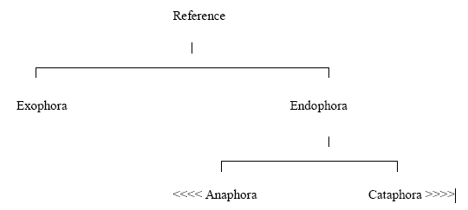
Types of references
We can summaries reference with a diagram to make it easier to understand:

Slide 17
Exophoric reference
Exophoric reference, depends on the context outside the text for its meaning.
In linguistics, Exophora is reference to something extra-linguistic or extra knowledge.
For example
  "What is this?",
    Here "this" is exophoric rather than endophoric, because it refers to something extra-linguistic, i.e. there is not enough information in the utterance (a spoken word, statement), itself to determine what "this" refers to, but we must instead observe the non-linguistic context of the utterance (e.g. the speaker might be holding an unknown object in their hand as they ask that question.).

Slide 18
Endophoric reference
The pronouns refer to items within the same text; it is endophoric reference.
Endophora is a linguistic reference to something intra-linguistic.
  For Example:
  "I saw Sally yesterday. She was lying on the beach".
    Here, "she" is intra-linguistic, and hence endophoric, because it refers to something (Sally, in this case) already mentioned in the text.

Slide 19
Endophora is an expression that refers to something in the same text.
Example:
I saw Nadia on the weekend. She was in the market.
Here "she" is an endophora since it refers to something mentioned in the text, namely, “nadia" here.
She was in the market.

Slide 20
Endophora (Another Definition)
Words or phrases like pronouns are endophora when they point backwards or forwards to something in the text:
  For example:
    As he was late, Harry wanted to phone his boss and tell her what had happened.

Slide 21
Types of Endophora
1) Cataphora:
  The type of endophora in which the referring expression(pronouns) occur before the referent are termed as cataphora.
  OR The type of endophora in which the pronouns link forward to a referent (nouns) in the text that follows.
  Mean pronouns occur before nouns.
  For example:
    When [she] ¹ saw the snake, [Harry] ¹ cried.
    The elevator opened for [him] ¹ on the 14th flour, and [Ali] ¹ stepped out quickly.

Slide 22
Types of Endophora
2) Anaphora:
  The type of endophora in which the referent occurs before the referring expression(pronouns) are termed as anaphora.
  Mean nouns occur before pronouns.
  OR The type of endophora in which the pronouns link backward to a referent (nouns) in the text.
  For example: (1) When harry saw the snake, she cried.
  (2) John helped Mary. He was kind

Slide 23
Anaphoric and Cataphoric Devices
The referring elements (pronouns) in anaphoric text that refer to their corresponding referent ( nouns) backward are called anaphoric devices. Also, called anaphor.
  For example:
    Bell is a powerful player but unfortunately he will not take part in the trophy due to injury.
The referring elements (pronouns) that refer to their corresponding referent (nouns) forward in cataphoric text are called cataphoric devices. Also, called cataphor.
  For example:
    As her father went abroad, Nighat took control of the organization by herself.
Anaphoric Device
Cataphoric Device

Slide 24
Antecedent
The referent in the anaphoric/cataphoric text to which the anaphoric/cataphoric devices refer are called antecedents.
Also, called correlates .
  For example:
    Bell is a powerful player but unfortunately he will not take part in the trophy due to injury.
    As her father went abroad, Nighat took control of the organization by herself.
    Bell is antecedent of he and nighat is antecedent of her.
Antecedent

Slide 25
Types of Anaphora (On the basis of position of anaphor and its antecedent)
Intra-sentential/Sentence internal anaphora:
  The anaphora in which the AD and its antecedent both occurs in the same sentence is called sentence internal.
  For example:
    [John] ¹ took [his] ¹ [hat] 2 off and hung [it] 2 on a peg.

Slide 26
Types of Anaphora (Cont..)
Inter-sentential/Sentence external anaphora:
  The anaphora in which the AD and its antecedent doesn’t occur in the same sentence is called sentence external or inter-sentential anaphora.
  For example:
    [Jehansher] ¹ Khan was senior player of Sqash. [He] ¹ has won several trophies.

Slide 27
Anaphora and ambiguity
Many anaphors are ambiguous. Like:
  A)
    Jane told Marry she was in love (ambiguous)
    Jane informed Marry she was in love. (Here Jane is in love)
  B)
    Jane told marry she was in danger (ambiguous)
    Jane warned Marry she was in danger.(Here marry is in danger)

Slide 28
2) Ellipsis
Definition:
  The omission or skip of a portion, of a phrase or a sentence is called Ellipsis. But the meaning is still clear.
  Ellipsis" is also the name of the symbol "
  Example:
    He is rich, but his brother is not ᶲ.

Slide 29
Other examples
George bought a huge box of chocolates but few Ǿ were left by the end of the day.
    I have never been go to Karachi but my father has Ǿ , and he says it was wonderful.
Chocolate
Been go to Karachi

Slide 30
Origin of the word ellipsis
Derived from Greek, the word 'ellipsis' means “the omission of words that could be understood from the context”.
Ellipsis is the non-expression of one or more sentence elements whose meaning can be reconstructed either from the context or from a person’s knowledge of the world.

Slide 31
e-clause & a-clause
e-clause:
  The clause from which the material is missing is often referred to as the elliptical clause (e-clause).
  Example:
    He is rich, but his brother is not ᶲ.
    or
  An elliptical clause is a clause in which some words have been left out. Because of the pattern or logic of the entire sentence, it is clear what the missing words are.
  Example: Ahmad had five dollars; Ali, ᶲ three.
  (The word had was dropped from the second clause, but the meaning is still clear.)

Slide 32
a-clause:( antecedent clause )
  The clause from which the interpretation of the missing material is derived from referent is called antecedent clause (a-clause).
  Example:
    Ali is rich, but his brother is not ᶲ.

Slide 33
Ellipsis resolution
Ellipses resolution is an important area in the research community.
All natural languages have the occurrences of ellipses in their text as well as speech, although different from each other.

Slide 34
Examples of ellipsis resolution
He is rich, but his brother is not ᶲ.
(= He is rich but his brother is not rich).
Bob ᶲ and Tom ate cheese.
(= Bob (ate cheese) and Tom ate cheese).
John realizes that john is a fool, but Bill does not ᶲ, even though his wife does ᶲ.
(= John realizes that john is a fool, but Bill does not realize that bill is a fool, even though Bill's wife realizes that Bill is a fool.)

Slide 35
3) Substitution
Substitution
  Substitution is very similar to ellipsis in the effect it has on the text, and occurs when instead of leaving a word or phrase out, as in ellipsis, it is substituted for another, more general word.
  {example}
    "Which ice-cream would you like?“
    "I would like the pink one"
      "one" is used instead of repeating "ice-cream."
      So one is substitution .

Slide 36
4) Conjunction
Conjunction
  Conjunction creates cohesion by relating sentences and paragraphs to each other by using words from the class of conjunction, or numerals.
  This can be:
    temporal (after, before),
    causal (because),
    coordinating (and),
    adversative (but, however),
    additive (further , or)
    discourse markers (now, well, after all).

Slide 37
5) Lexical cohesion
Lexical Cohesion
In text, lexical cohesion is the result of chains of related words that contribute to the continuity of lexical meaning.
  Lexical cohesion is basically created by repetition (reiteration) of the same lexeme, or general nouns, or other lexemes sharing the majority of semantic features and have same meaning:
  Exp: The bus ... - the vehicle ... the transport
  ....

Slide 38
For Example
There’s a boy climbing that tree .
The boy’s going to fall if he does not take care.
The lad’s going to fall if he does not take care.
The child’s going to fall if he does not take care.
The idiot’s going to fall if he does not take care.
In (a), boy is repeated. In (b), the reiteration takes the form of a synonym lad. In (c), of the super ordinate term child, and in (d), of a general word idiot.

Slide 39
Cohesion vs coherence
Difference 1:
  Coherent:
    The semantic relationships which link the meanings of utterances ( a spoken word, statement) In a discourse.
  Cohesion:
    The grammatical and lexical relationships between the different elements of the text in a discourse.
Difference 2:
  Coherence:
    Coherence is a super set which means that if a text is coherent then it will also be cohesive but the converse is not true
  Cohesion:
    It is a sub set of coherence which means that if a text is cohesive then it may or may not be coherent.
Difference 3:
  Coherence:
    The relationship among the parts of the text and sentences is strong.
  Cohesion:
    The relationship among the parts of the text and sentences is casual.

Slide 40
The End
Life is 10% of what you face, and 90%
of how you respond to it
________________
Thank You
God Bless You

